Slide 1
PROJECT PHASE II – FINAL
ZIPCLIP: AI–DRIVEN CONTENT CLIPPING & REEL GENERATION SYSTEM
Team Members:
Anirudh K B
Abhijith R
Jesvin J
Under the guidance of
Mrs. Sabitha Raju
Head of the Department, CG

Slide 2
PROBLEM STATEMENT
Long-form videos are time-consuming to consume
Creators struggle to manually find engaging highlights
Lack of intelligent automation for reel creation
Existing tools focus only on trimming, not intelligent content detection
High processing time and effort for social-media optimized clips
No unified platform to analyze, generate, preview and export clips

Slide 3
OBJECTIVES
Develop an AI-powered platform to automatically extract highlights
Analyze video using visual, audio, and text cues
Generate short clips and story reels automatically
Improve engagement quality while maintaining efficient processing
Export platform-ready outputs (Shorts, Reels, TikTok)

Slide 4
MOTIVATION
Explosive growth of short-video platforms
Creators need faster content turnaround
Manual editing requires time, expertise and effort
AI advancements enable automated highlight detection
Demand for scalable, reliable and reusable clip generation tools

Slide 5
LITERATURE REVIEW
Key Papers
SumBot: Summarize Videos Like a Human
Video summarization using deep learning techniques: a comprehensive review
Video summarization for event-centric videos
AI-driven video summarization for optimizing content search and retrieval efficiency
Zero-shot scene change detection

Slide 6
RESEARCH GAPS
SumBot: Summarize Videos Like a Human
Uses linear reward modelling
Limited to semi-structured domains (e.g., sports)
Not generalized for diverse creator content
Video summarization using deep learning techniques: a comprehensive review
Limited evaluation on real-time and interactive systems
Bias in commonly used datasets
Focuses on models, not end-to-end deployable platforms

Slide 7
RESEARCH GAPS
Video summarization for event-centric videos
Designed mainly for event-centric content
Not evaluated on short-form social media videos
Limited adaptability across diverse video domains
AI-driven video summarization for optimizing content search and retrieval efficiency
Optimized for search and retrieval, not content creation
Evaluation limited to YouTube-style platforms
Lacks user-centric preview and editing support

Slide 8
RESEARCH GAPS
Zero-shot scene change detection
May miss subtle or semantic transitions
Focuses only on scene boundaries
Does not consider emotional or contextual importance

Slide 9
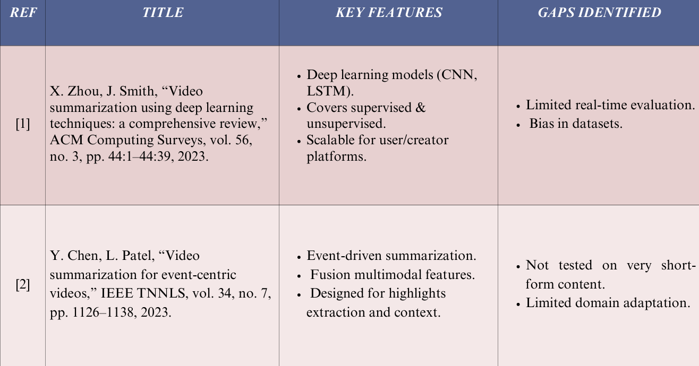
LITERATURE REVIEW

Slide 10
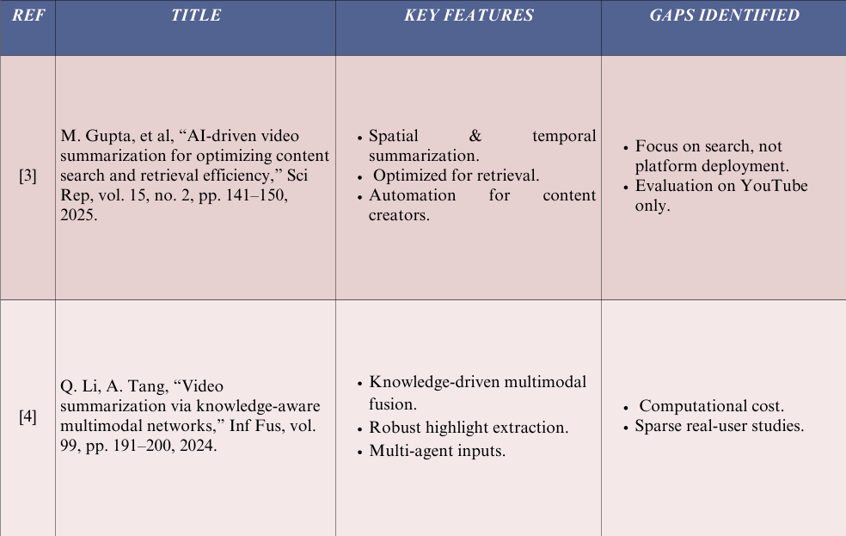
LITERATURE REVIEW

Slide 11
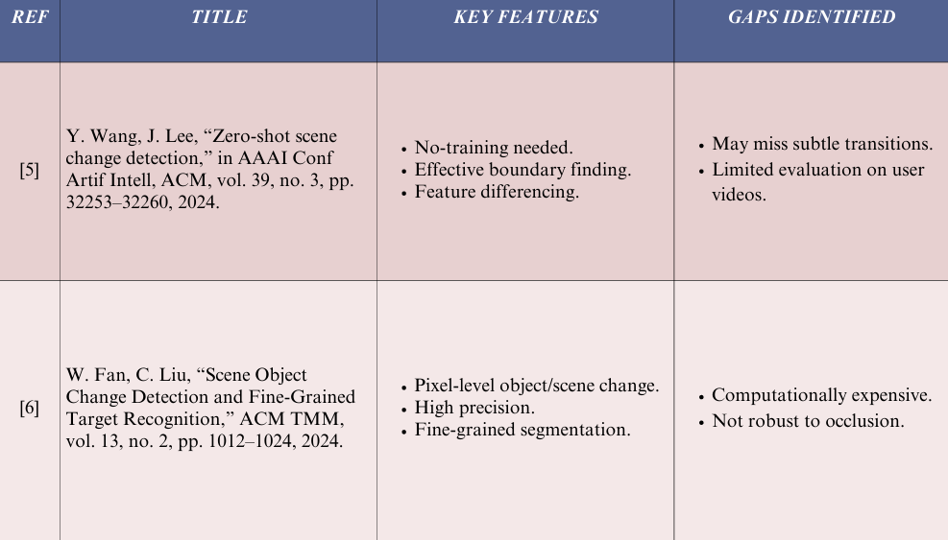
LITERATURE REVIEW

Slide 12
PROPOSED SOLUTION
ZipClip automates highlight extraction and reel creation using AI Multimodal analysis:
– Video frame analysis
– Audio transcription
– NLP-based context understanding
User dashboard for preview and manual fine-tuning
Generate platform-optimized vertical short-form videos

Slide 13
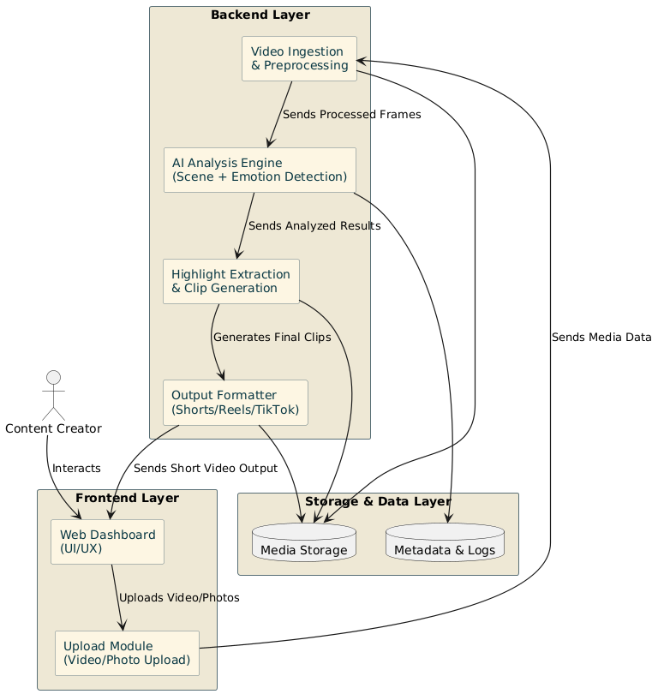
SYSTEM ARCHITECTURE

Slide 14
NOVELTY & SCOPE
Combined transcript, scene, and visual analysis for highlight extraction
Automated story reel creation from photos
Bridges gap between AI-assisted automation and creator productivity
Modular, scalable, cloud-deployable architecture
Full stack AI content automation platform
Supports long videos + photo-based reel creation
Preview support for generated clips
Future expandability to direct social media publishing

Slide 15
TEAM ROLE & TASK DISTRIBUTION
Jesvin J – Backend AI pipelines, processing engine, database Anirudh K B – Frontend dashboard, video upload and playback module & UI implementation Abhijith R – System architecture design, UI & UX design, frontend-backend integration, testing and project documentations

Slide 16
IMPLEMENTATION
Data Processing and Extraction
Video Input Handling: The system accepts multiple video formats such as MP4, MOV, AVI, and MKV through a web-based upload interface.
Audio Extraction & Transcription: FFmpeg is used to extract audio tracks from uploaded videos, while OpenAI Whisper generates timestamp-based textual transcripts.
Scene Detection & Segmentation: SceneDetect-based shot boundary detection is used to identify scene transitions and divide videos into meaningful segments.
Transcript Analysis: GPT-assisted NLP processing analyzes transcripts to identify relevant keywords, important moments, and highlight-worthy segments.
Smart Video Processing: OpenCV-based face detection and motion-aware cropping are used to generate vertical short-form videos optimized for mobile viewing.
Subtitle Generation: Timestamp-aligned subtitles are automatically generated and overlaid onto the final video using FFmpeg and ImageMagick.

Slide 17
IMPLEMENTATION
Multi-Modal AI Analysis
Multi-Modal Integration: The system concurrently analyzes visual, audio, and textual signals to ensure a balanced highlight selection.
Transcript-Based Highlight Detection: Whisper-generated transcripts are analyzed using GPT-assisted NLP techniques to detect contextually relevant and highlight-worthy moments.
Narrative Coherence: The segmentation foundational layer ensures that the extracted highlights maintain a logical flow without abrupt visual discontinuities.
Smart Cropping & Focus Tracking: OpenCV-based face detection and motion-aware cropping ensure important subjects remain centered in vertical short-form output.

Slide 18
IMPLEMENTATION
System Integration
Modular Backend: Developed using Python-based modular services to support scalable AI inference and video processing.
API Framework: RESTful APIs facilitate communication between the feature extraction, analytical, and storage modules.
Containerization: Deployment environments are containerized (e.g., Docker) to enhance portability and execution efficiency across different computational setups.
User Interaction: A Web-based frontend allows users to upload files, select processing modes (e.g., transcript-based or scene-based), and preview results.

Slide 19
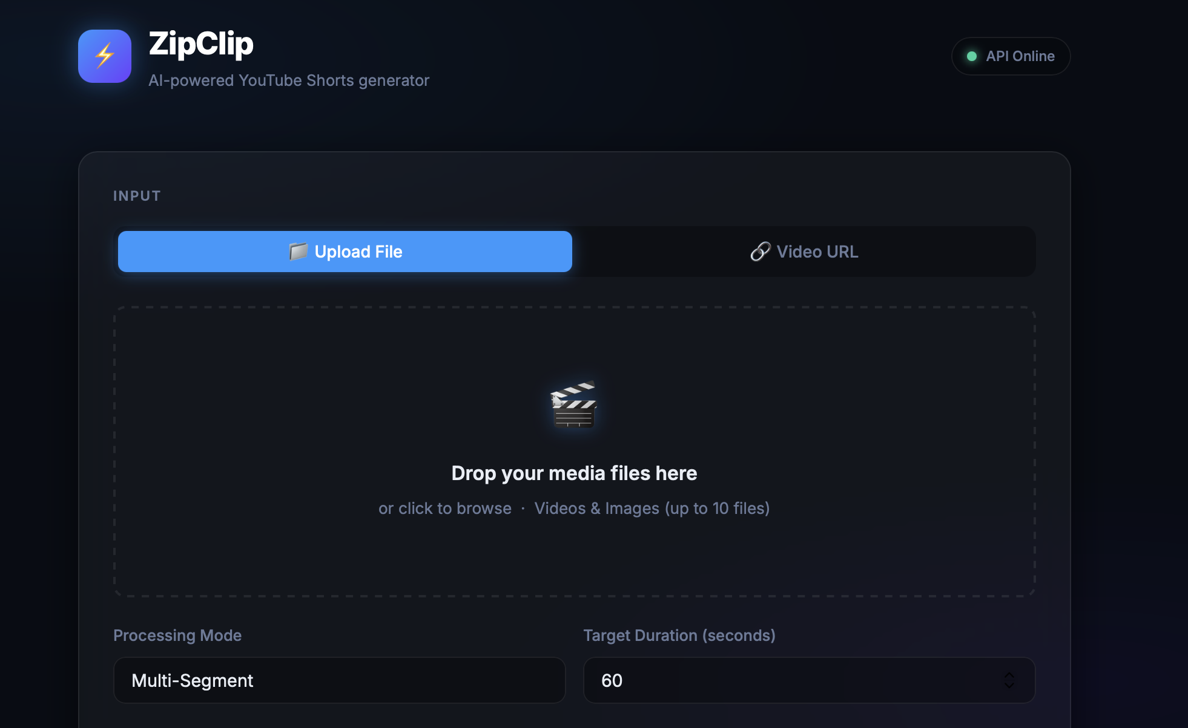
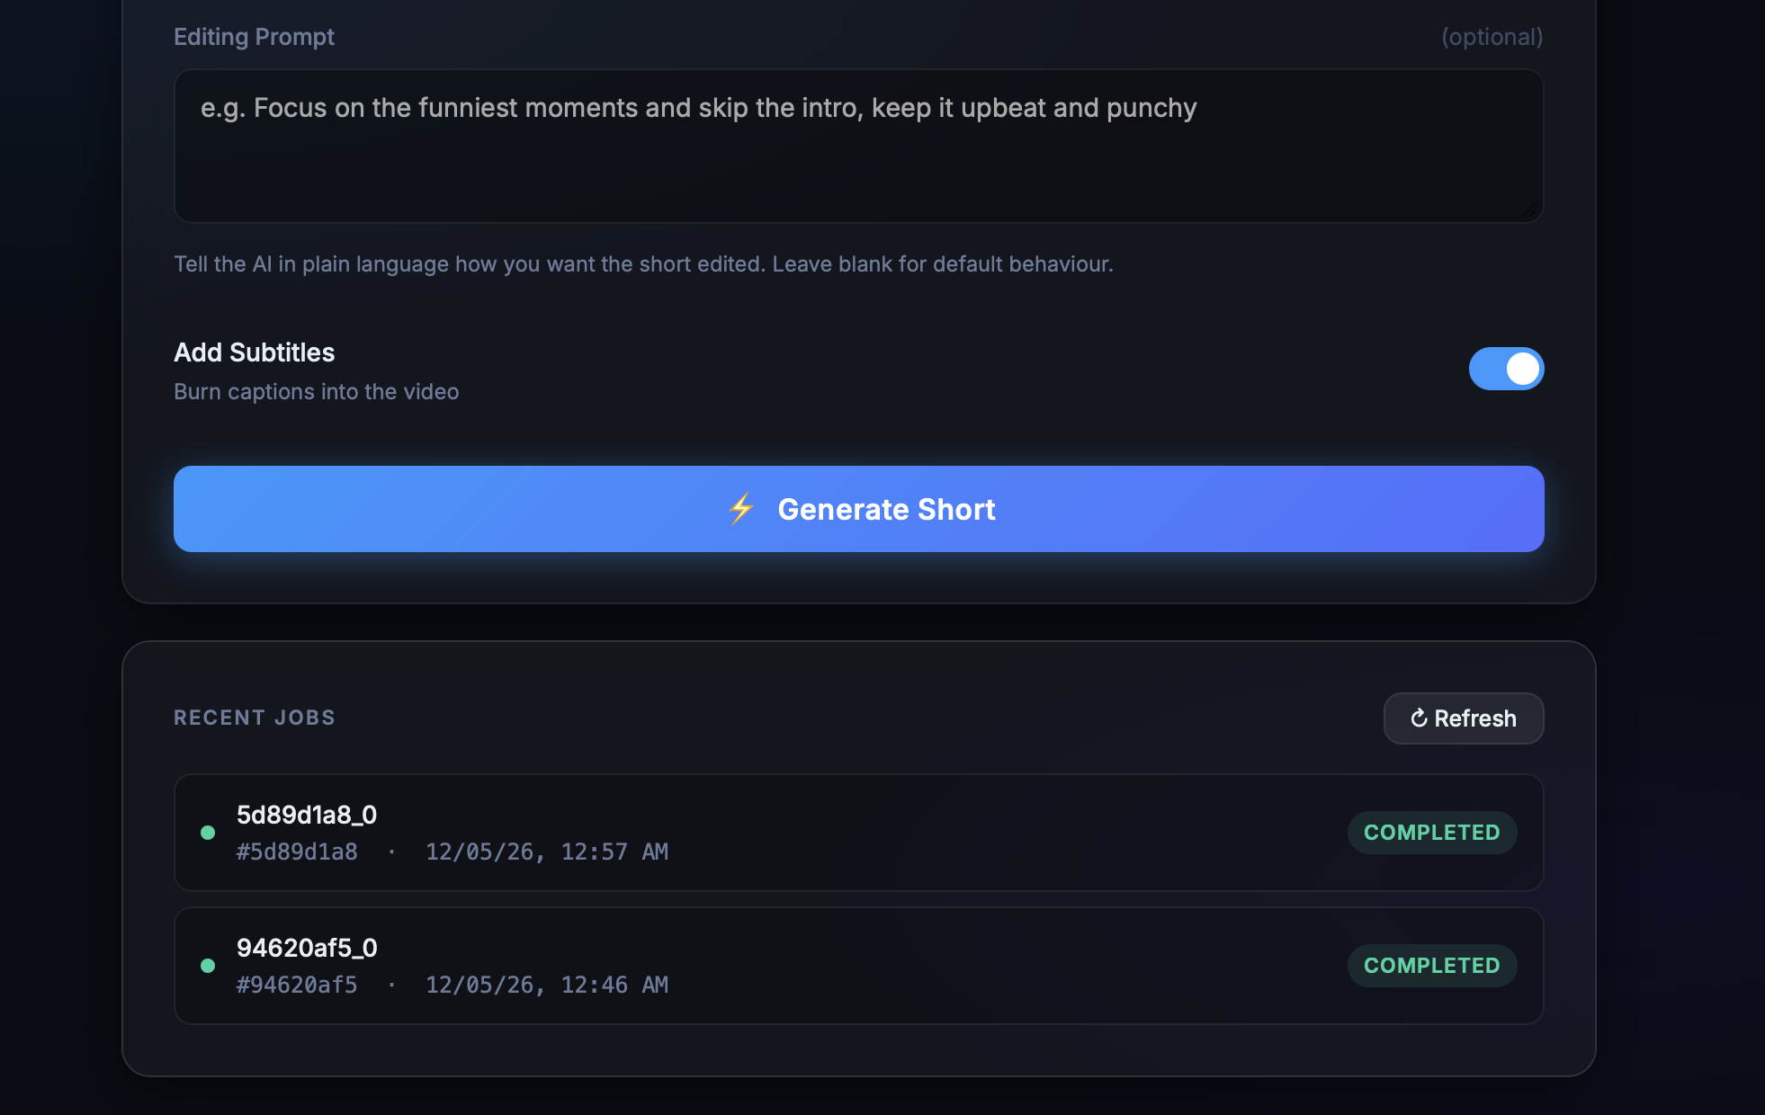
SCREENSHOTS

Slide 20
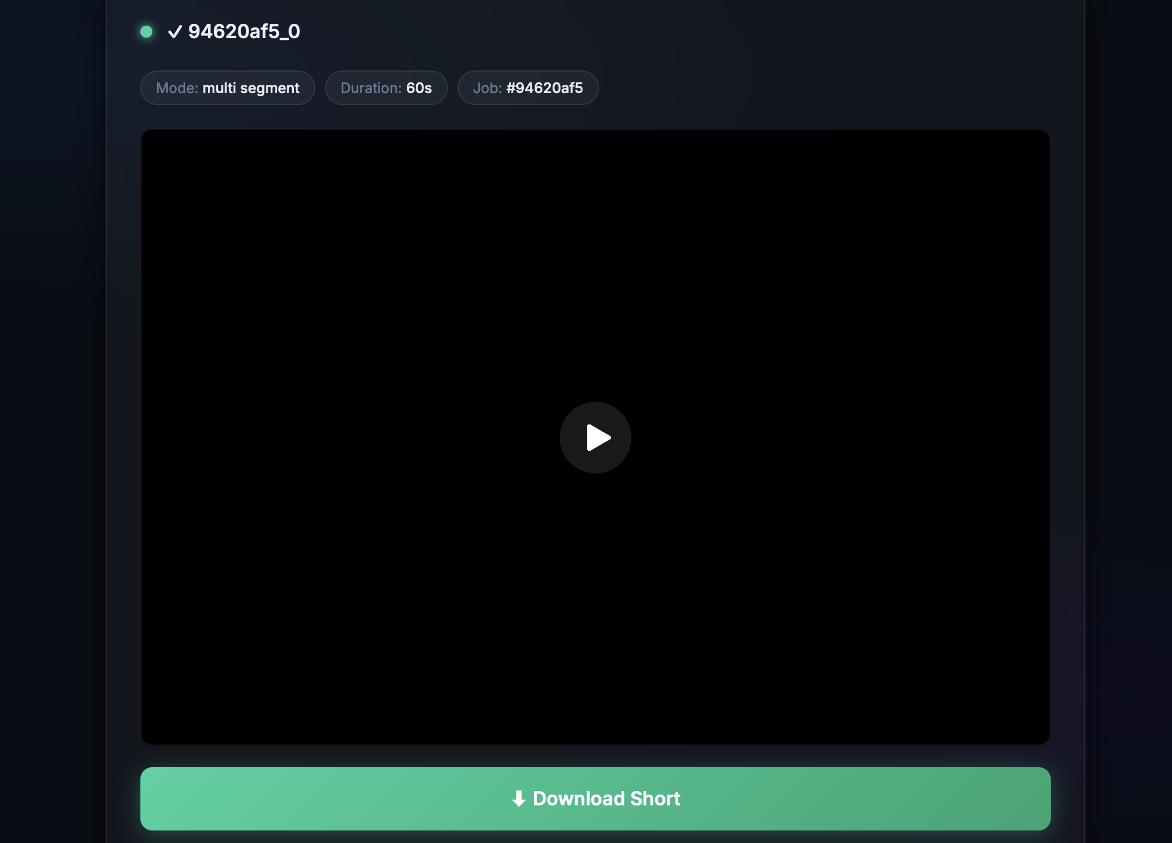
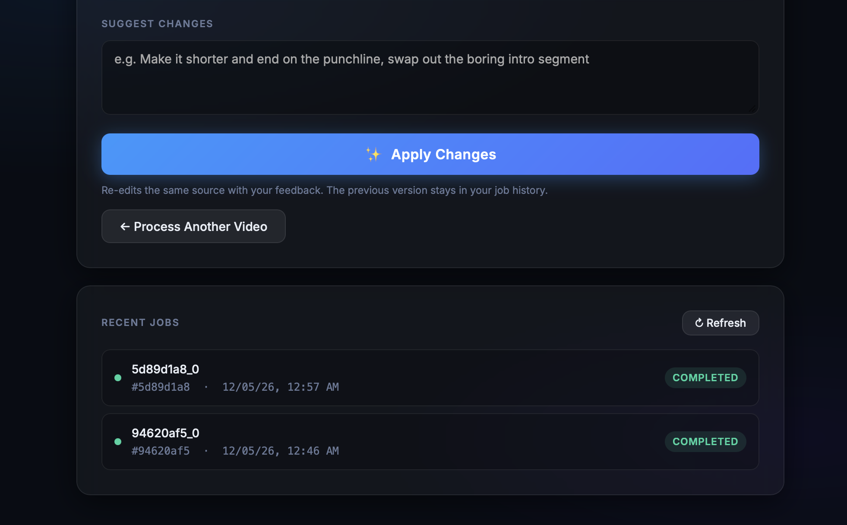
SCREENSHOTS

Slide 21
APPLICATIONS
Social Media Content Creation: Automating the generation of Reels, TikToks, and YouTube Shorts from long-form podcasts, interviews, and vlogs.
Digital Media Repositories: Optimizing content search and retrieval by generating concise previews of extensive video archives.
Corporate & Industrial Use: Repurposing recorded panel discussions, meetings, or webinars into structured, attention-focused segments for internal training or marketing.
Personalized Media Consumption: Enabling users to quickly consume the most "expressive" or "emotionally significant" parts of a video without manual review.

Slide 22
CHALLENGES & RISKS
High compute requirement for AI processing
Latency management
Integration complexity between modules
Dataset & model selection
Scalability concerns
Ensuring accuracy and engagement value

Slide 23
FUTURE ENHANCEMENTS
Direct Social Media API Integration: Developing automated pipelines to publish generated clips directly to platforms like YouTube Shorts, Instagram Reels, and TikTok.
Real-Time Processing Optimization: Enhancing backend efficiency to reduce latency during multi-modal analysis, enabling near real-time clip generation for live streams.
Advanced Predictive Engagement Analytics: Implementing AI models to predict the potential "virality" or audience engagement score of a clip before it is exported.
Robustness under Variable Conditions: Improving model stability to handle poor lighting, heavy background noise, and facial occlusions in non-studio recording environments.

Slide 24
CONCLUSION
Multi-Modal Success: ZIPCLIP successfully demonstrates that integrating visual, audio, and textual signals provides a more balanced highlight selection than single-modality approaches.
Efficiency in Content Creation: The framework effectively addresses the time-intensive nature of manual editing by automating the extraction of emotionally significant and contextually relevant clips.
Narrative Integrity: By utilizing structural segmentation, the system ensures that generated short-form content maintains narrative coherence and logical flow.
User-Centric Automation: The platform bridges the gap between AI research and practical application by providing a unified dashboard for generation, previewing, and exporting.
Scalability: The modular, containerized architecture allows the system to scale efficiently for high-volume content production across diverse video domains.

Slide 25
REFERENCE
H. Gu, S. Petrangeli and V. Swaminathan, "SumBot: Summarize Videos Like a Human," 2020 IEEE International Symposium on Multimedia (ISM), Naples, Italy, 2020, pp. 210-217.
X. Zhou, J. Smith, “Video summarization using deep learning techniques: a comprehensive review,” ACM Computing Surveys, vol. 56, no. 3, pp. 44:1–44:39, 2023.
Y. Chen, L. Patel, “Video summarization for event-centric videos,” IEEE TNNLS, vol. 34, no. 7, pp. 1126–1138, 2023.
M. Gupta, et al, “AI-driven video summarization for optimizing content search and retrieval efficiency,” Sci Rep, vol. 15, no. 2, pp. 141–150, 2025.
Y. Wang, J. Lee, “Zero-shot scene change detection,” in AAAI Conf Artif Intell, ACM, vol. 39, no. 3, pp. 32253–32260, 2024.

Slide 26
THANK YOU

